Slide 1
So you want a garden in your school?
by
David Lamb

Slide 2
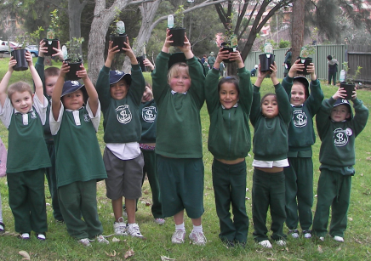
Content
Introduction
Where do you want the garden to be?
What design features would you like?
What is the garden primarily used for?
How will we utilise the garden?
Who is going to be part of the beginning process ?
Who can support us?
Other considerations
Reality check

Slide 3
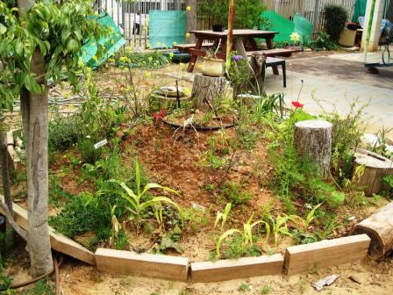
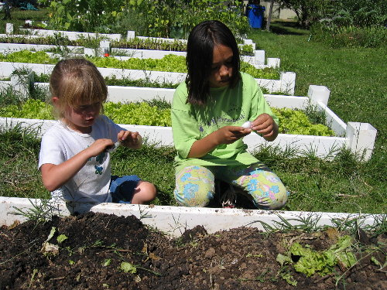
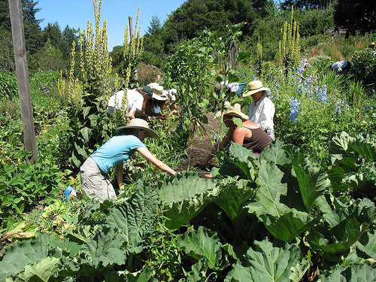
It doesn’t matter about the size

Slide 4
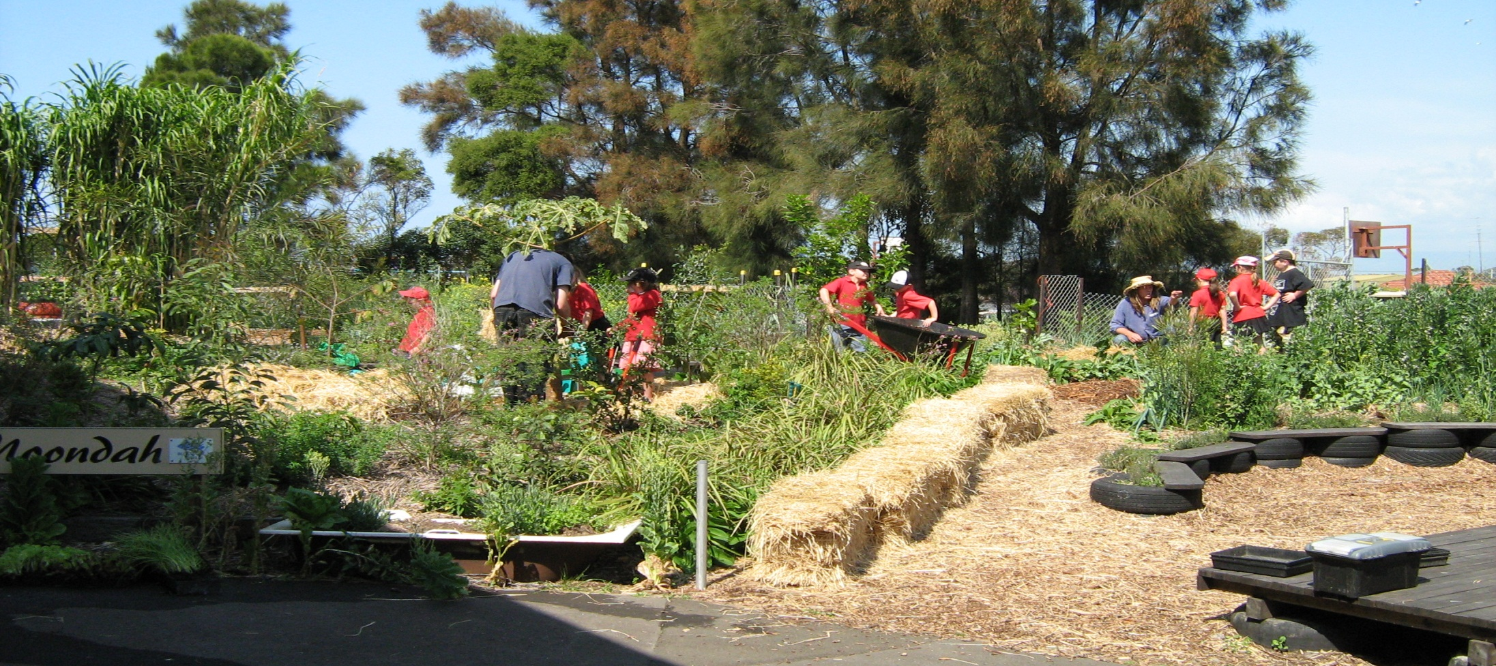
The most important thing is to remember it’s all about the students
Kemblawarra PS 2007

Slide 5
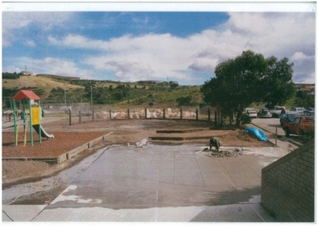
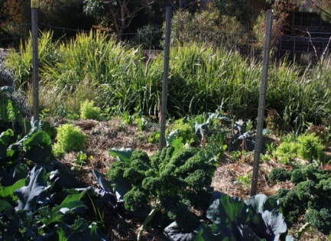
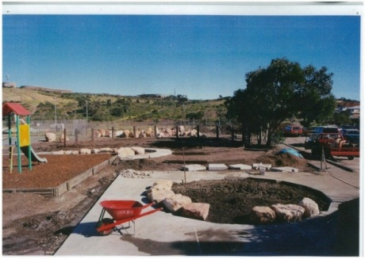
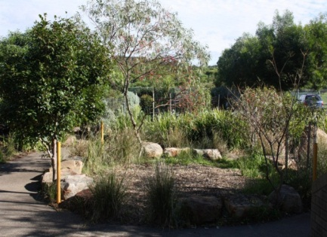
Cringila Public School
Permaculture Garden
2003
To
2011

Slide 6
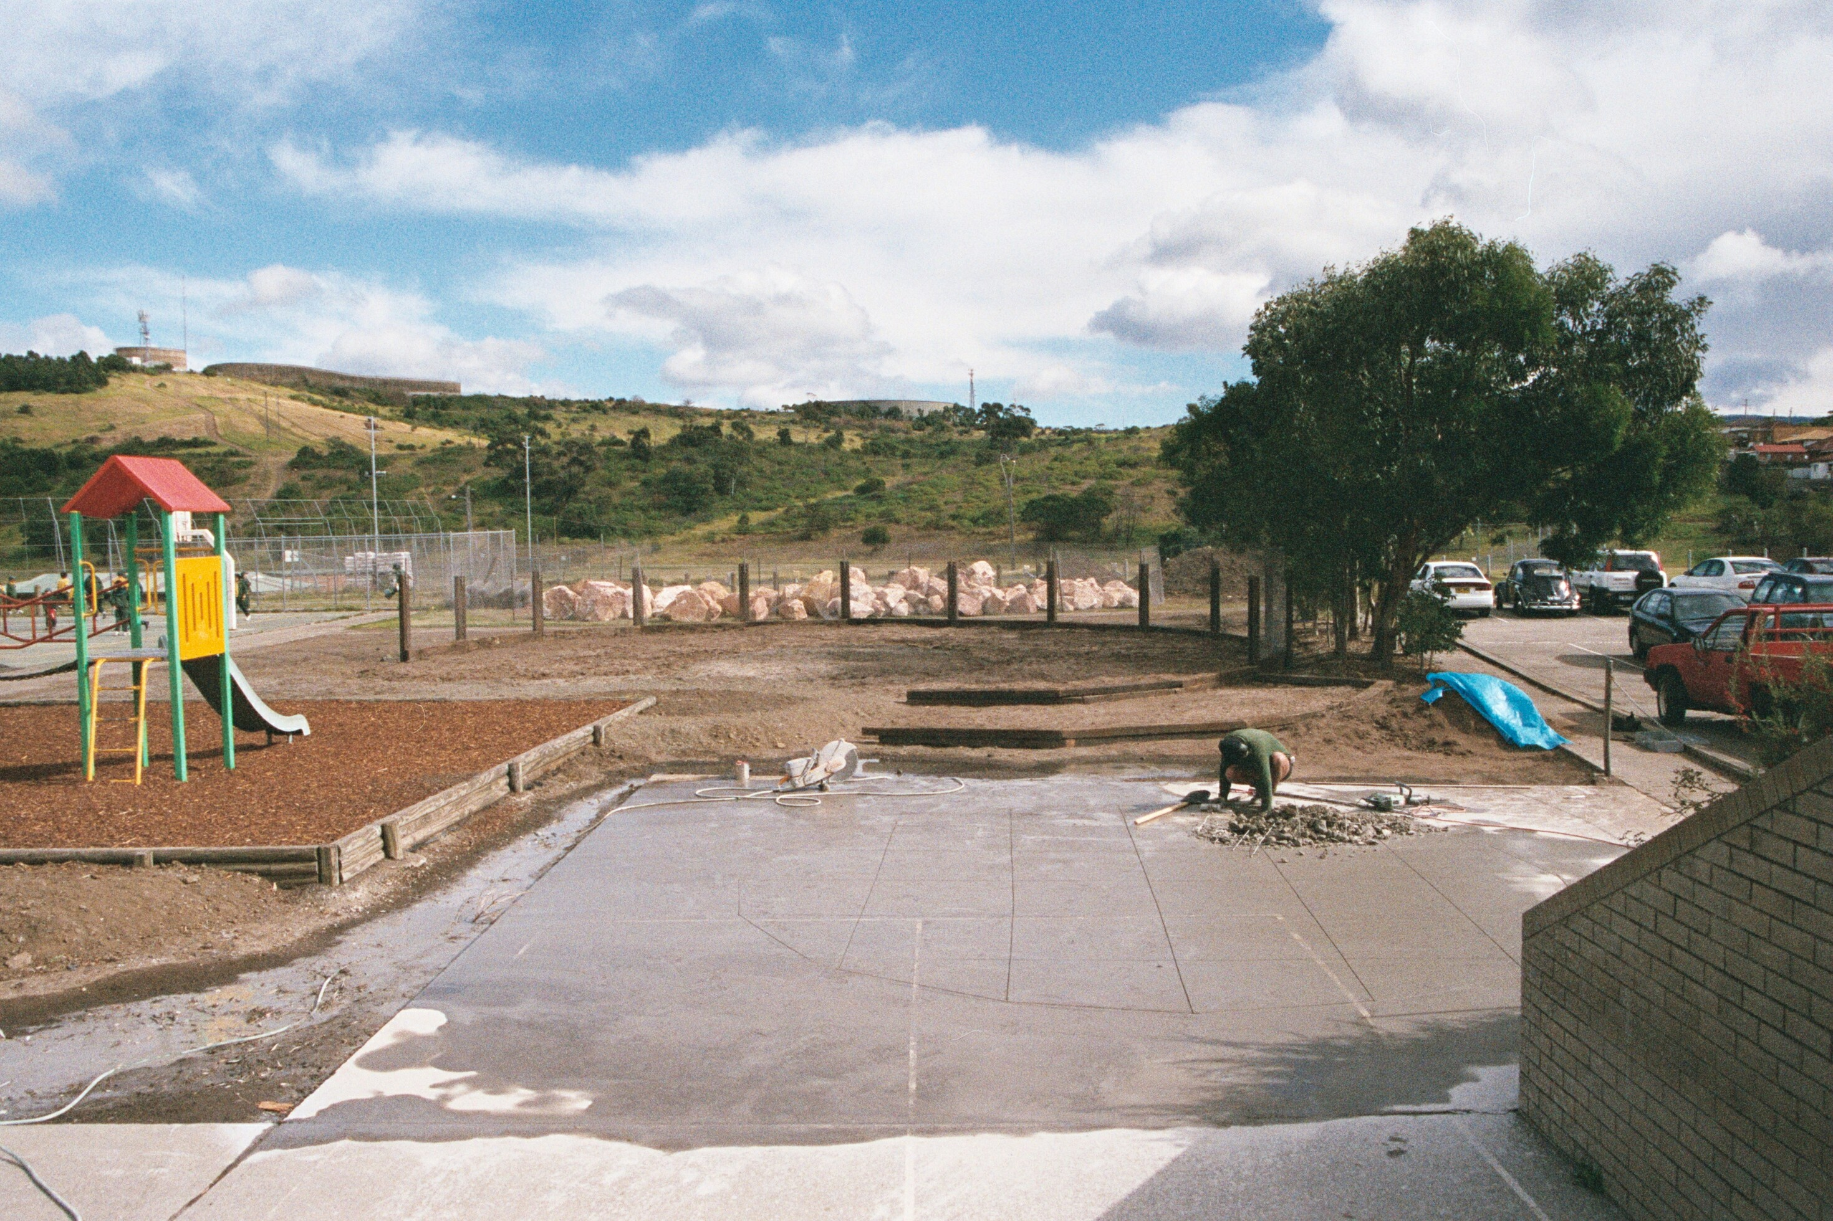
Cringila PS 2003

Slide 7
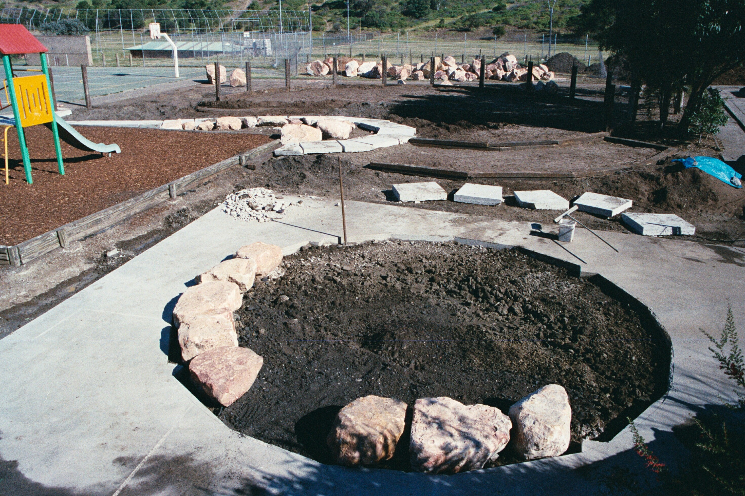
Cringila PS 2003

Slide 8
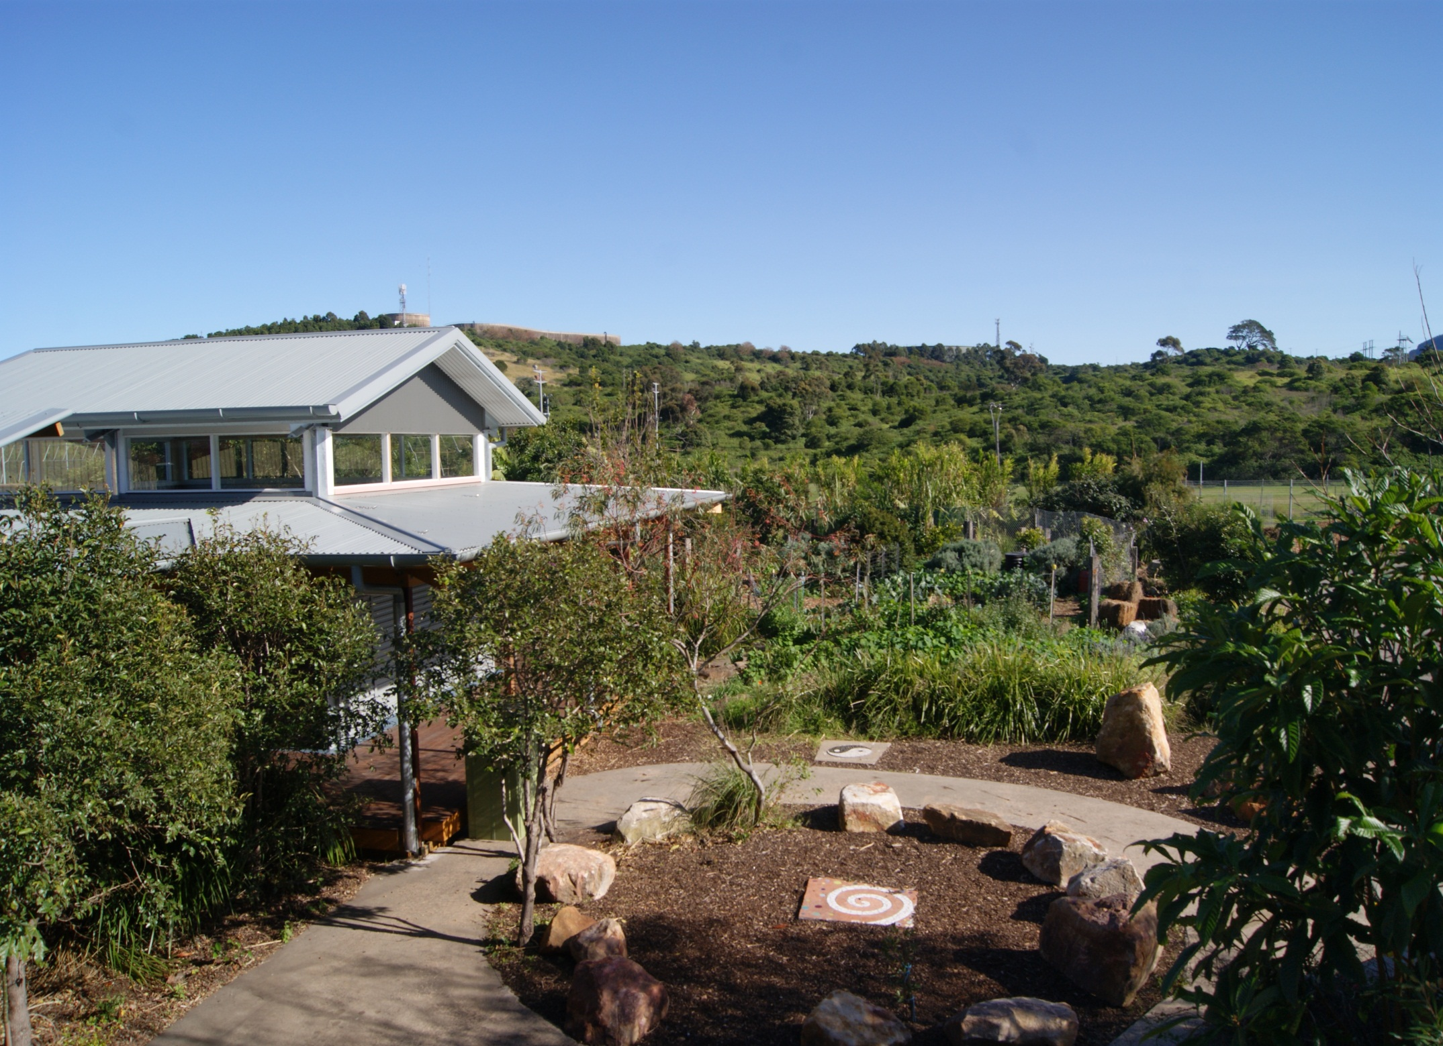
Cringila PS 2011

Slide 9
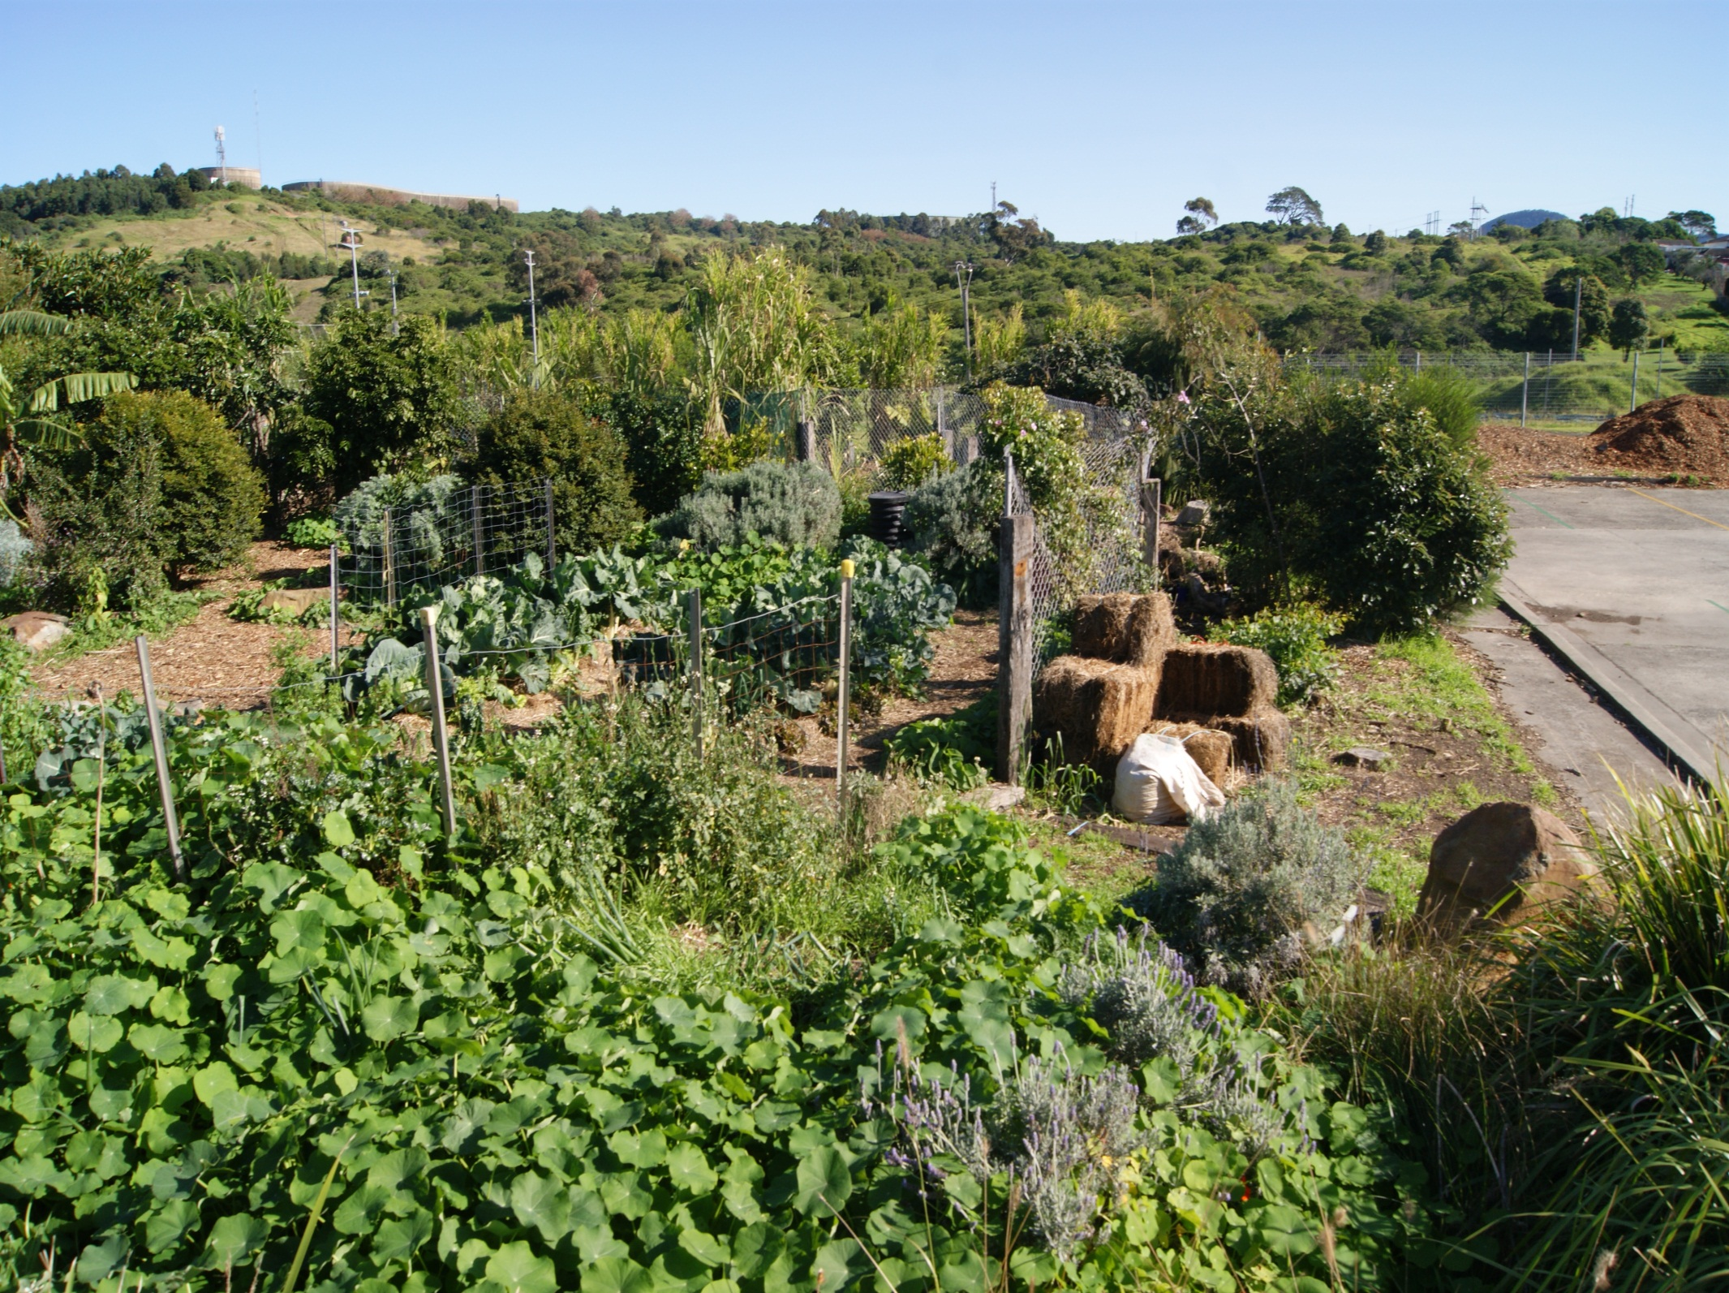
Cringila PS 2011

Slide 10
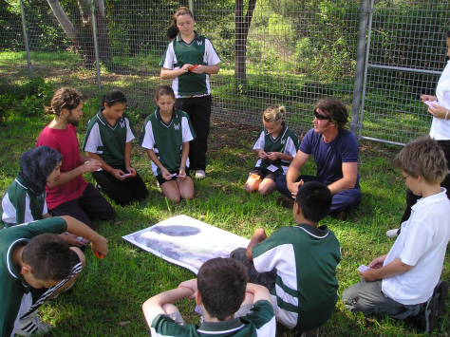
Where do you want the garden to be?
The best site
Weather aspects i.e. sun, wind, slope
Aesthetics
Practicalities
Is it tokenistic or is it in a place where the whole school community can access it?

Slide 11
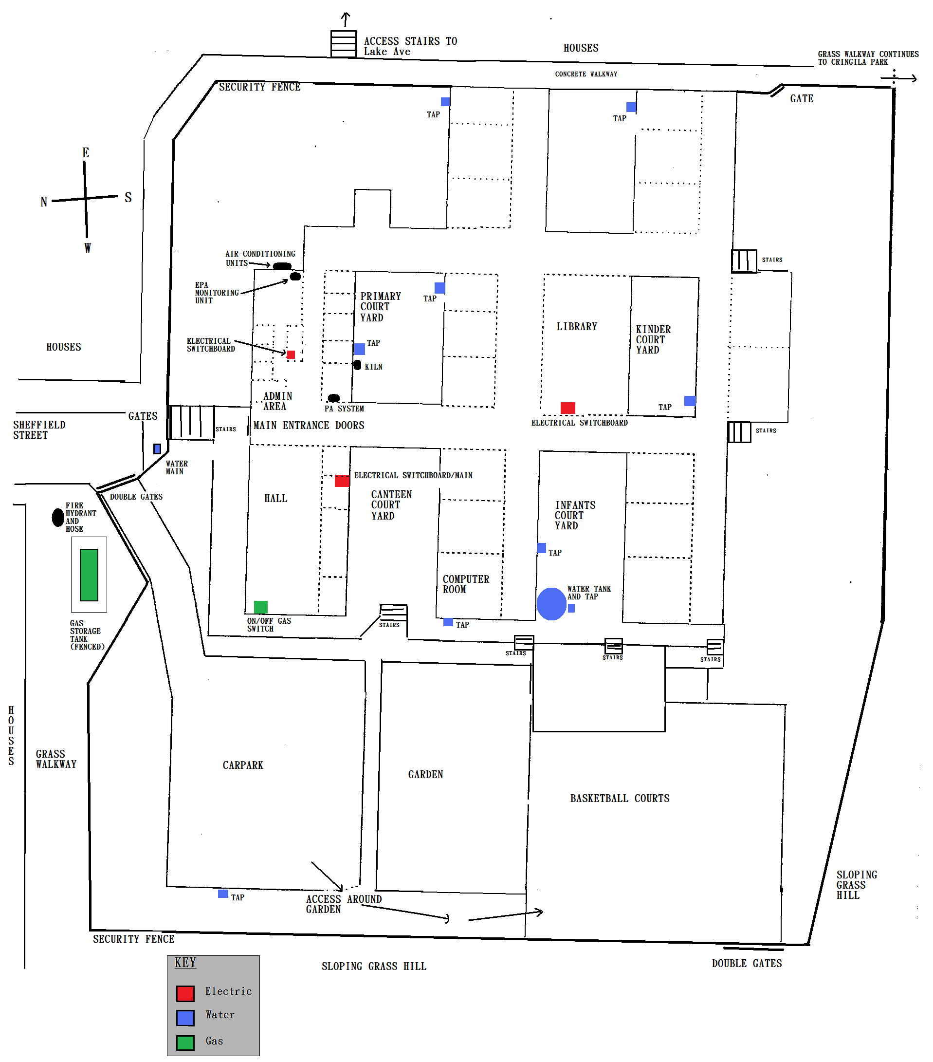
Map of Cringila School

Slide 12
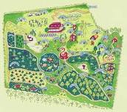
What design features would you like?
Traditional rows
Permaculture style
Functional combination of the two
Key hole
Elongated lines
The benefits of each
Ongoing maintenance and sustainability coming through in the design

Slide 13
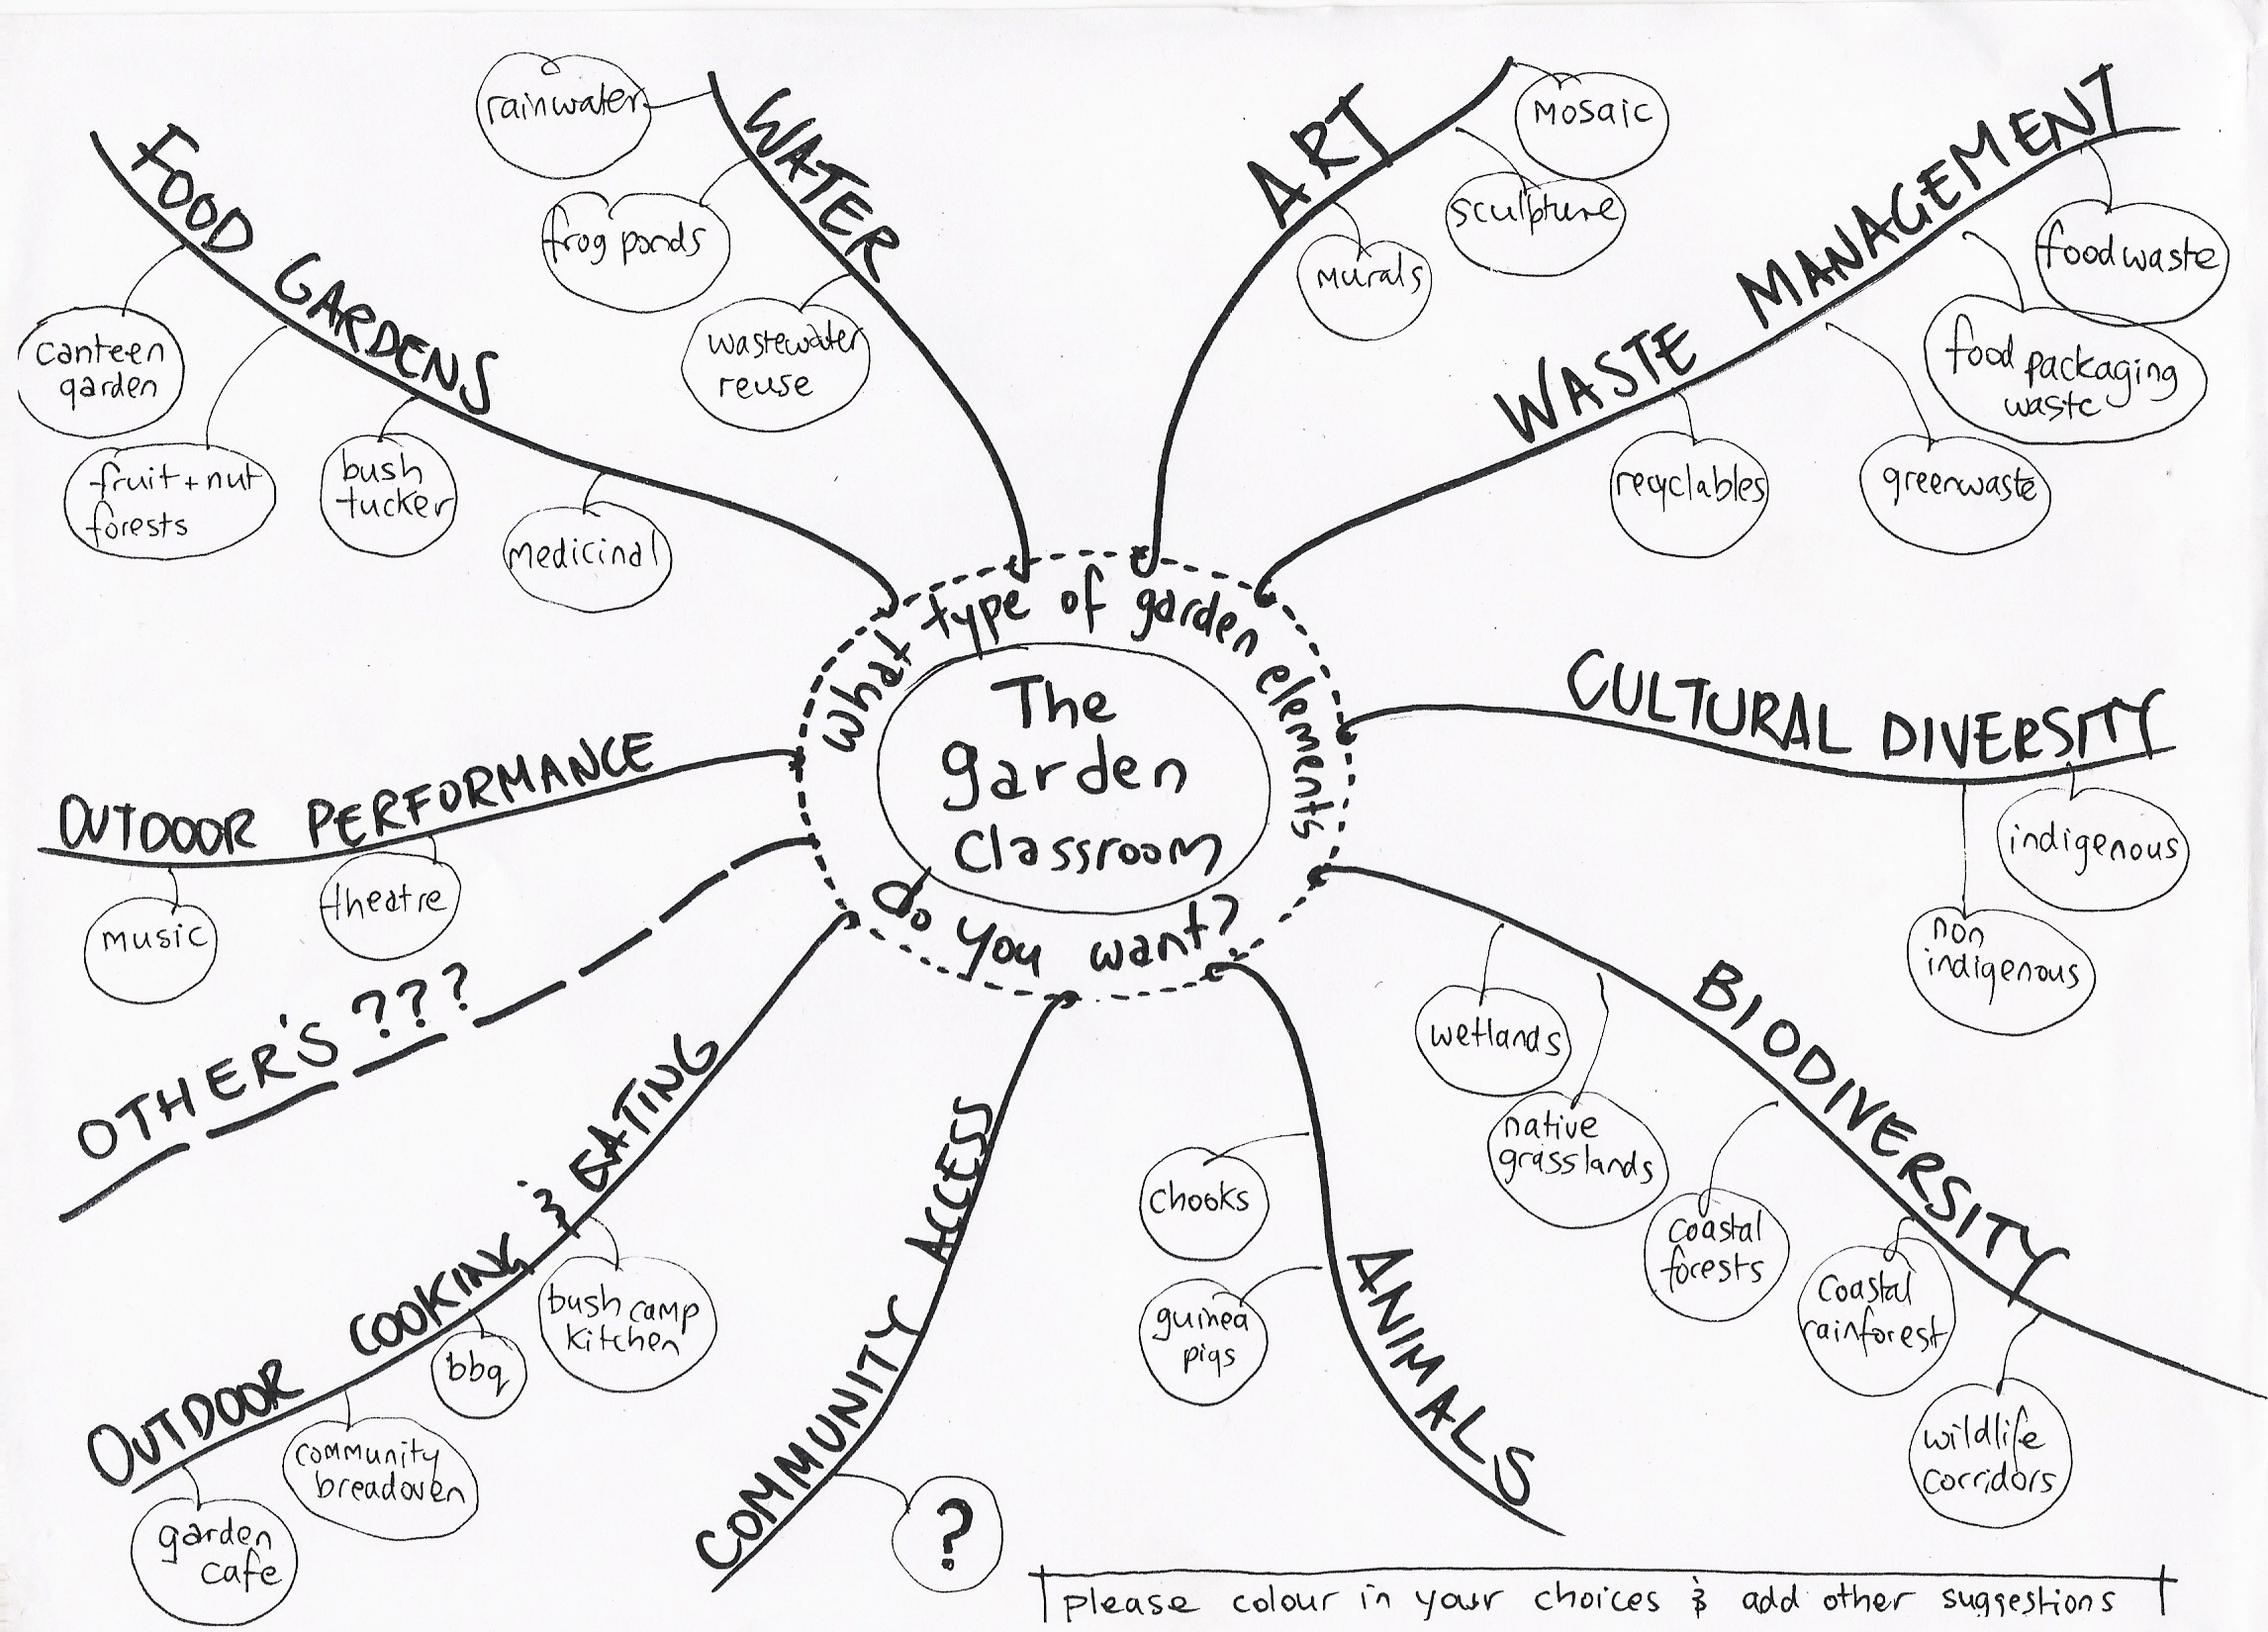
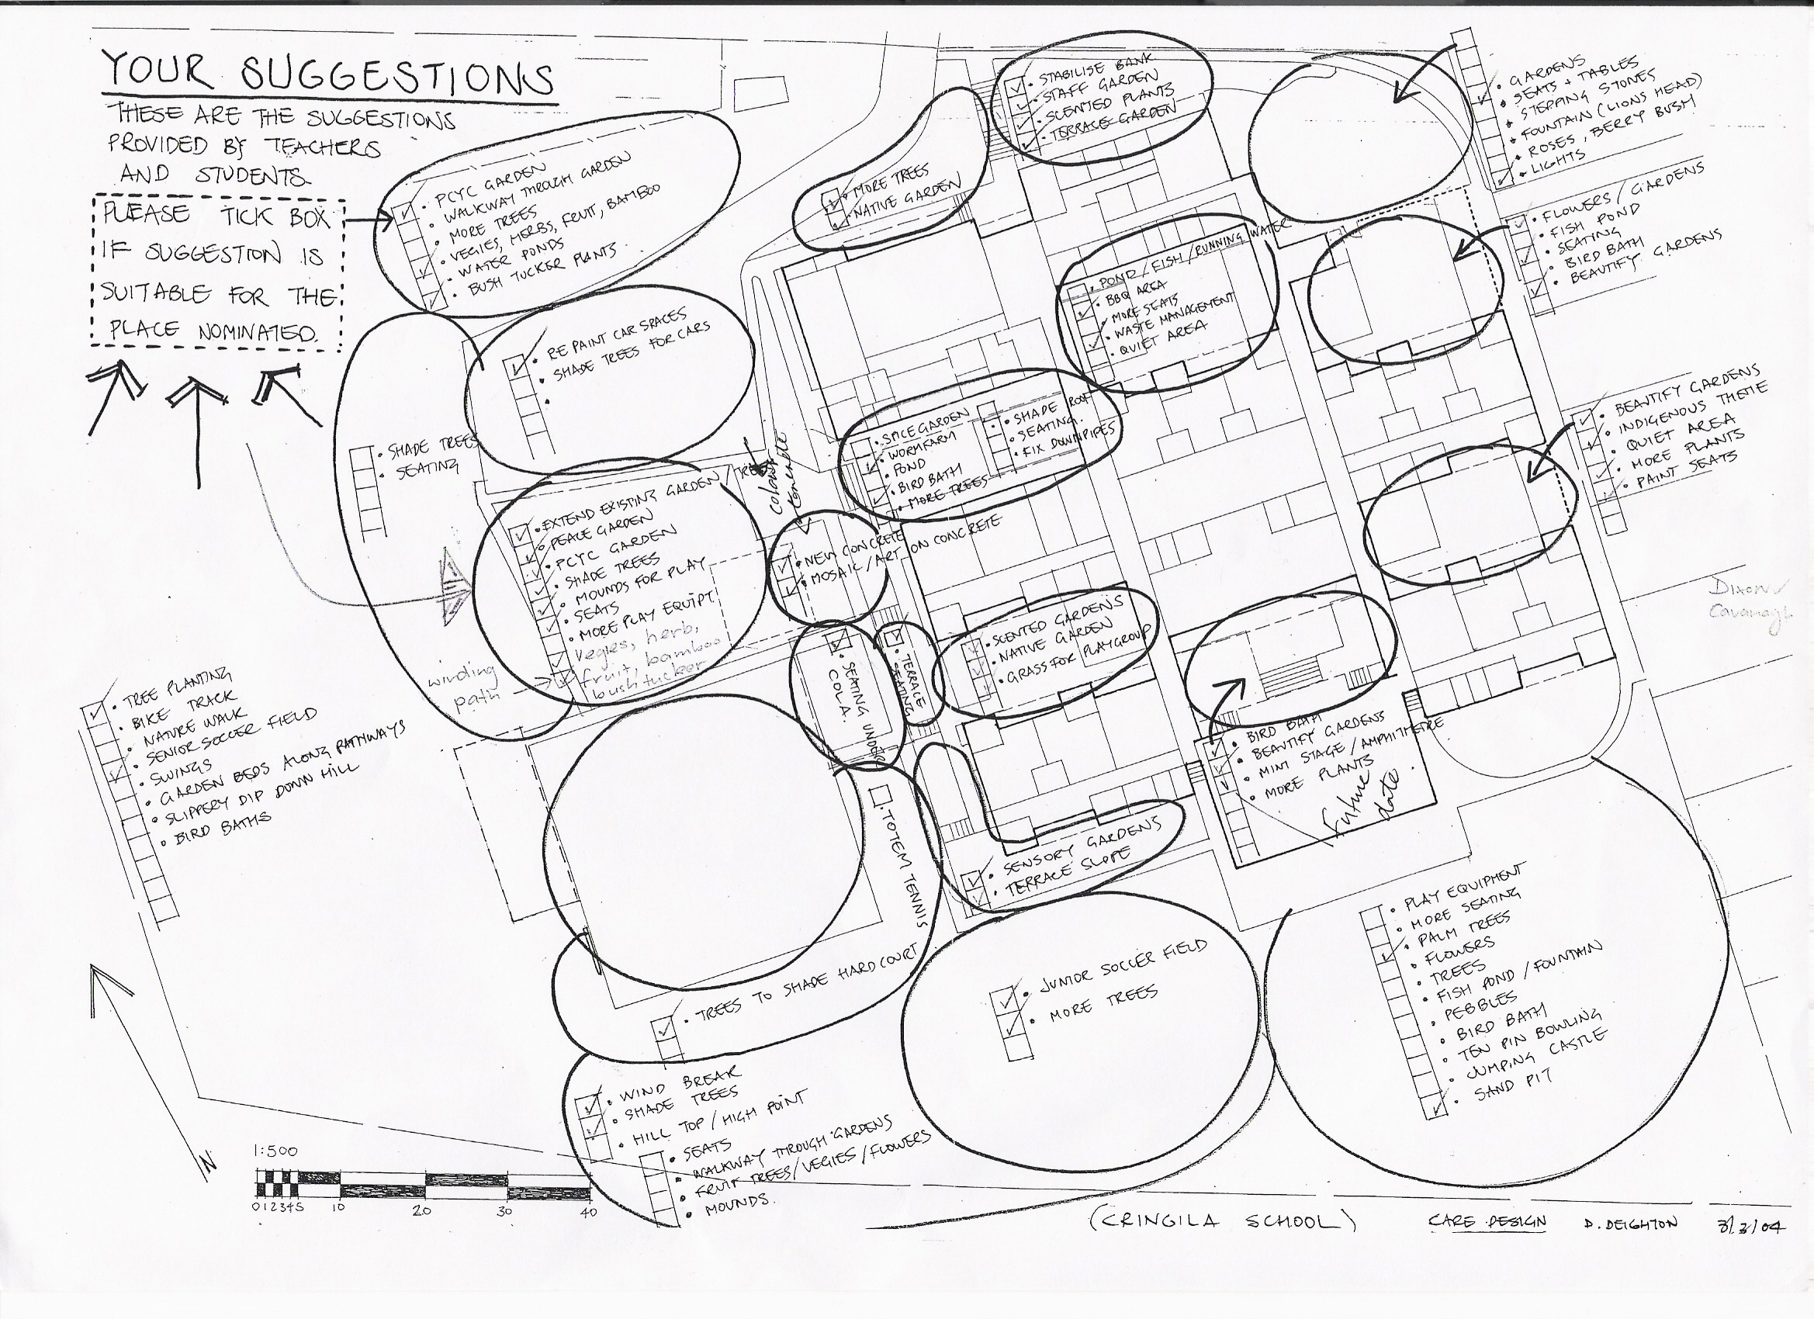
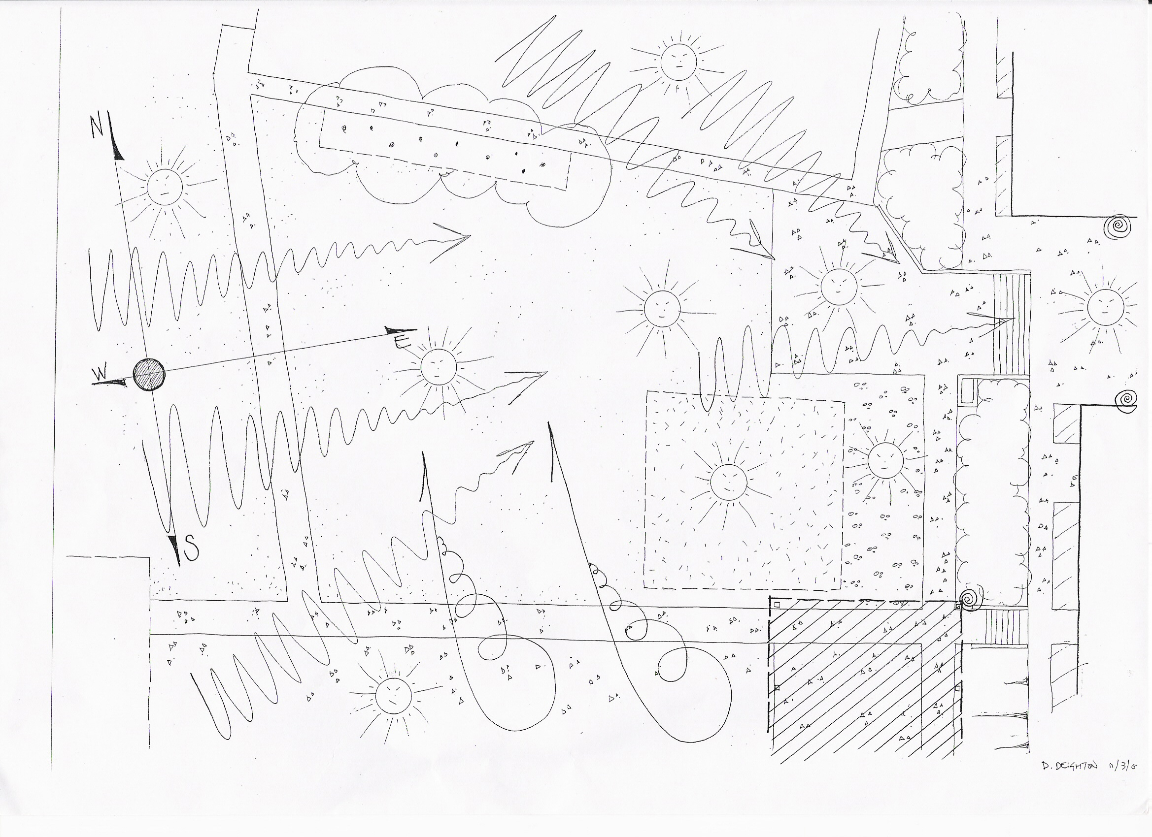
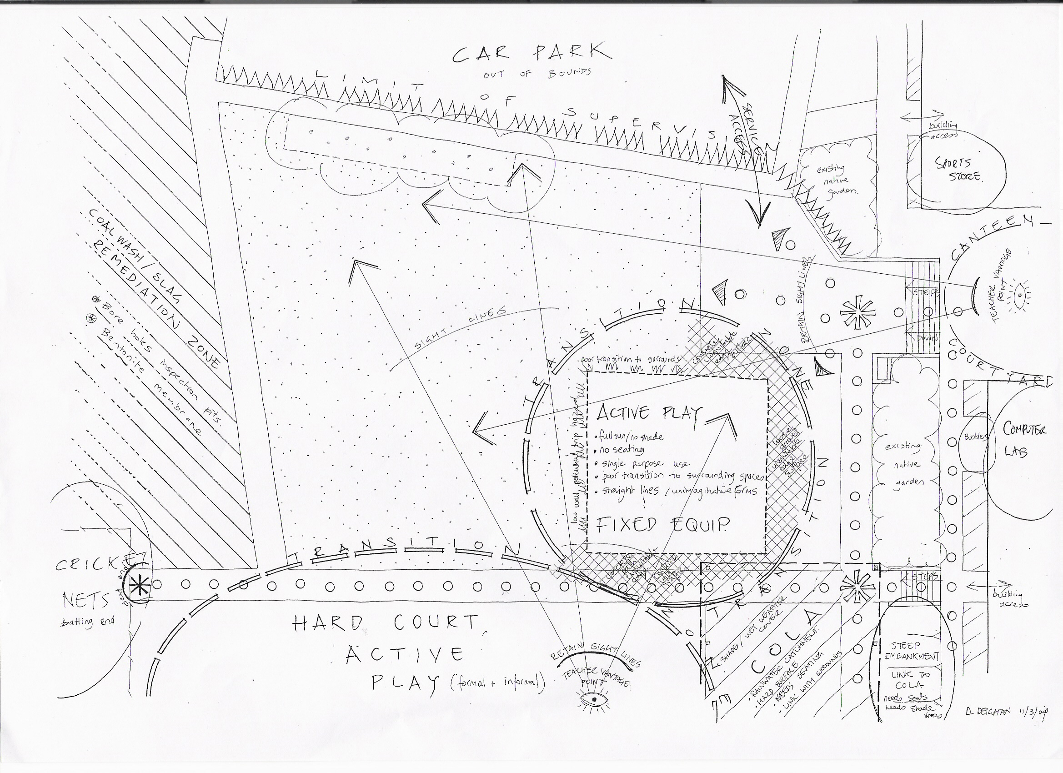
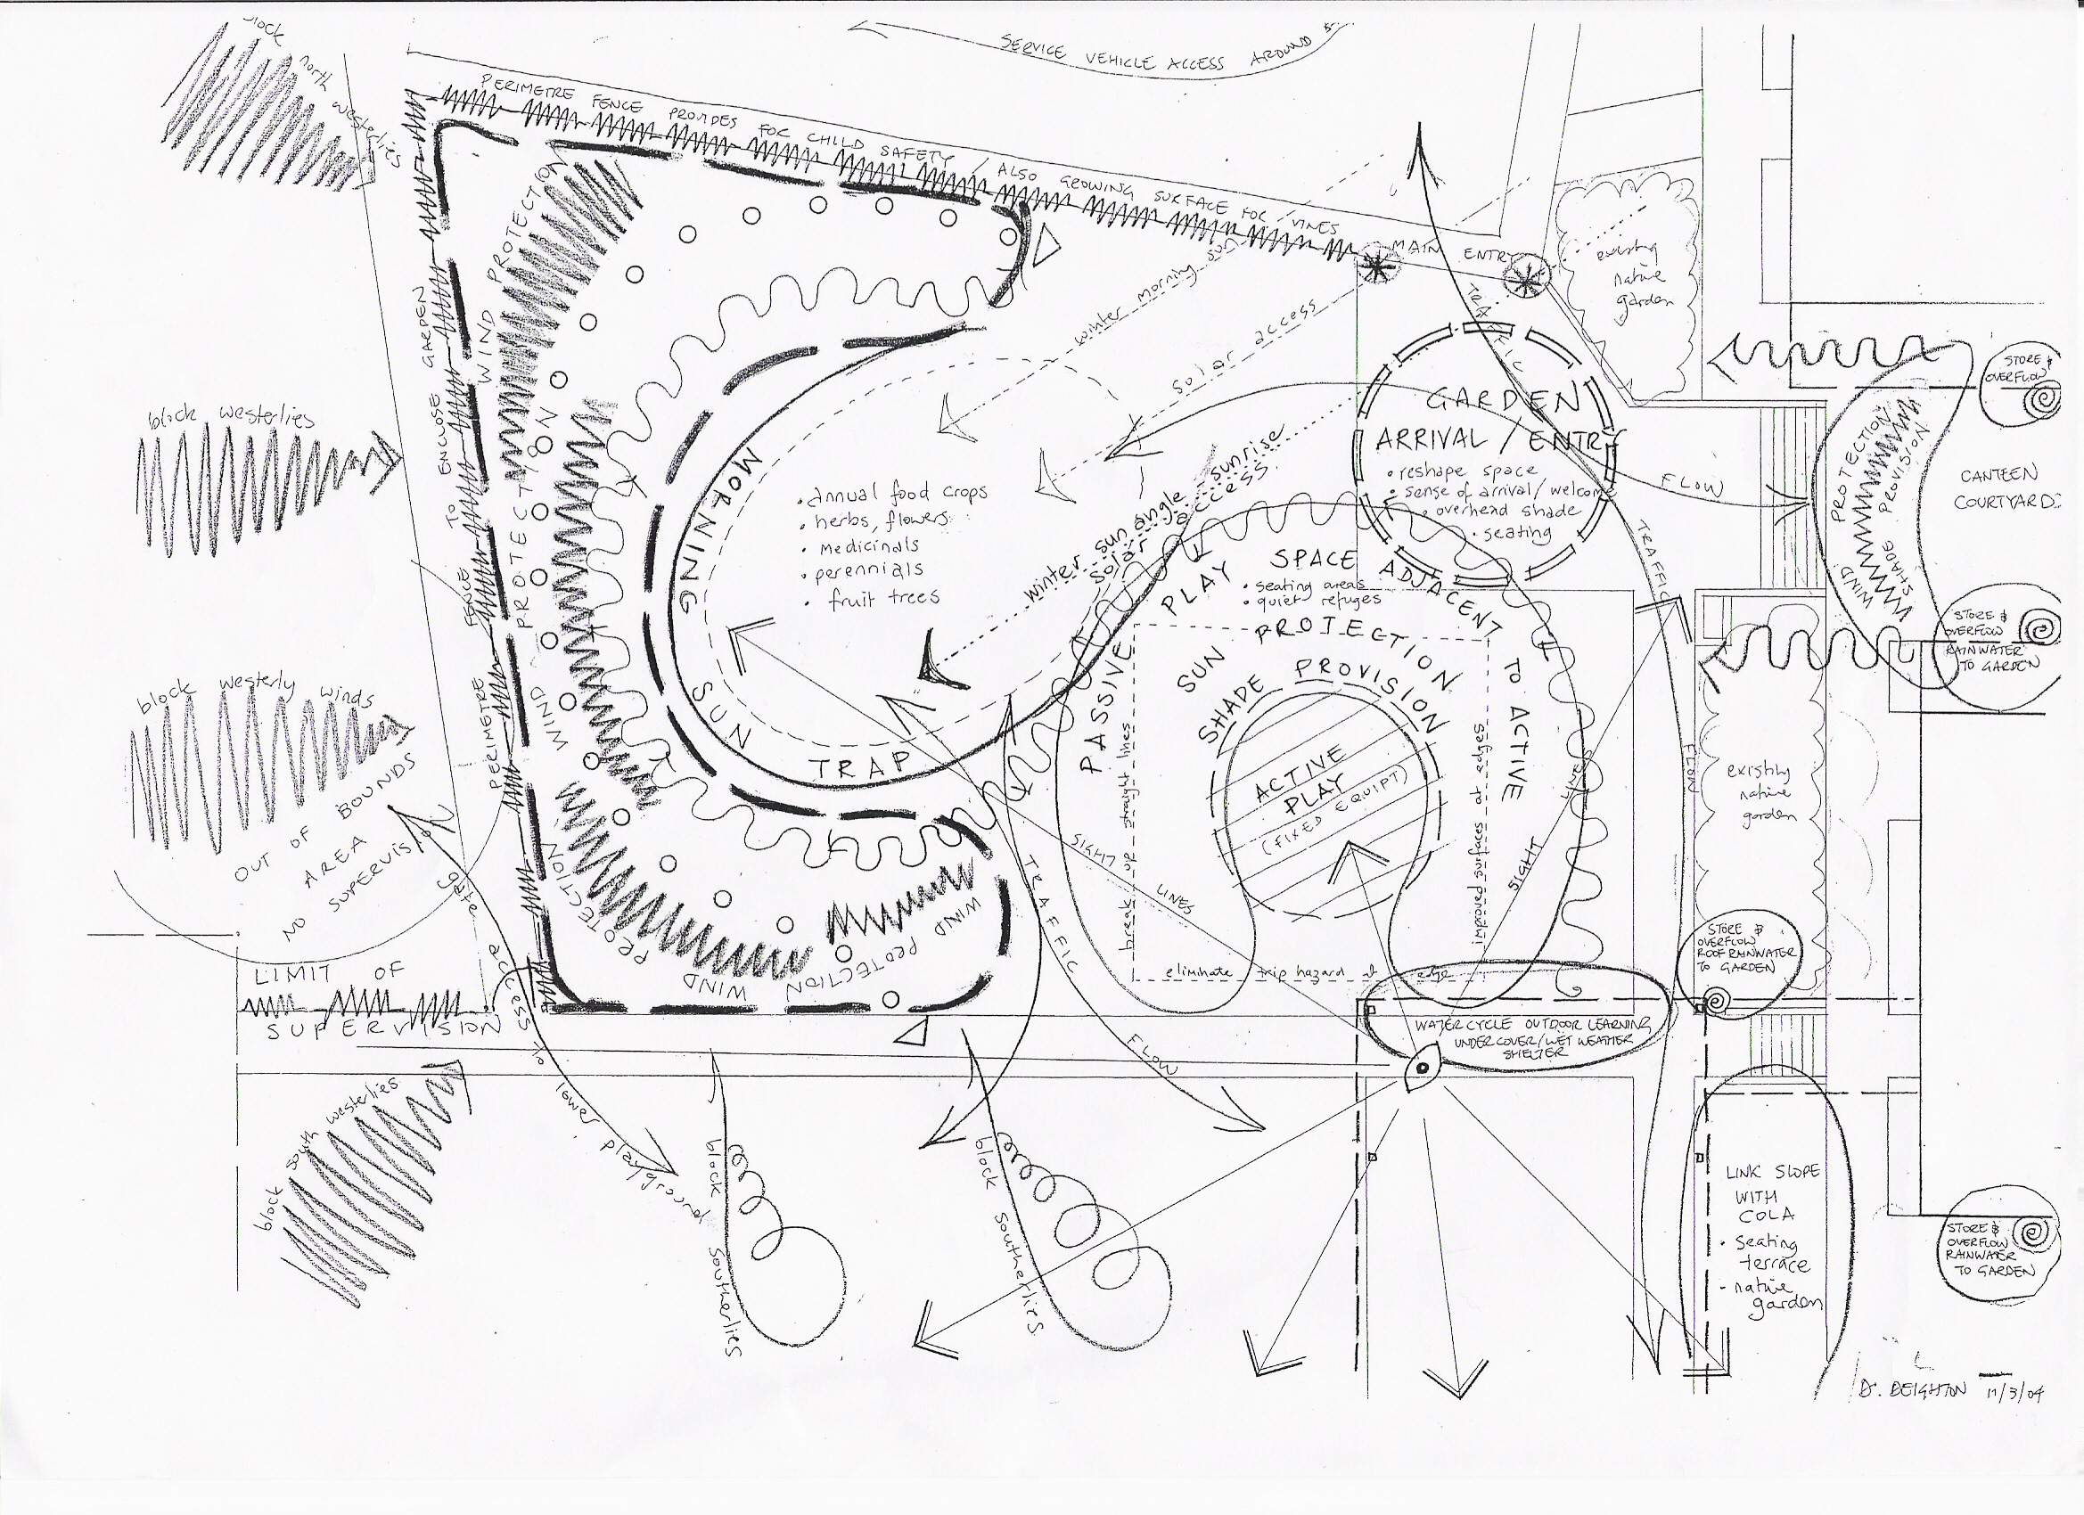
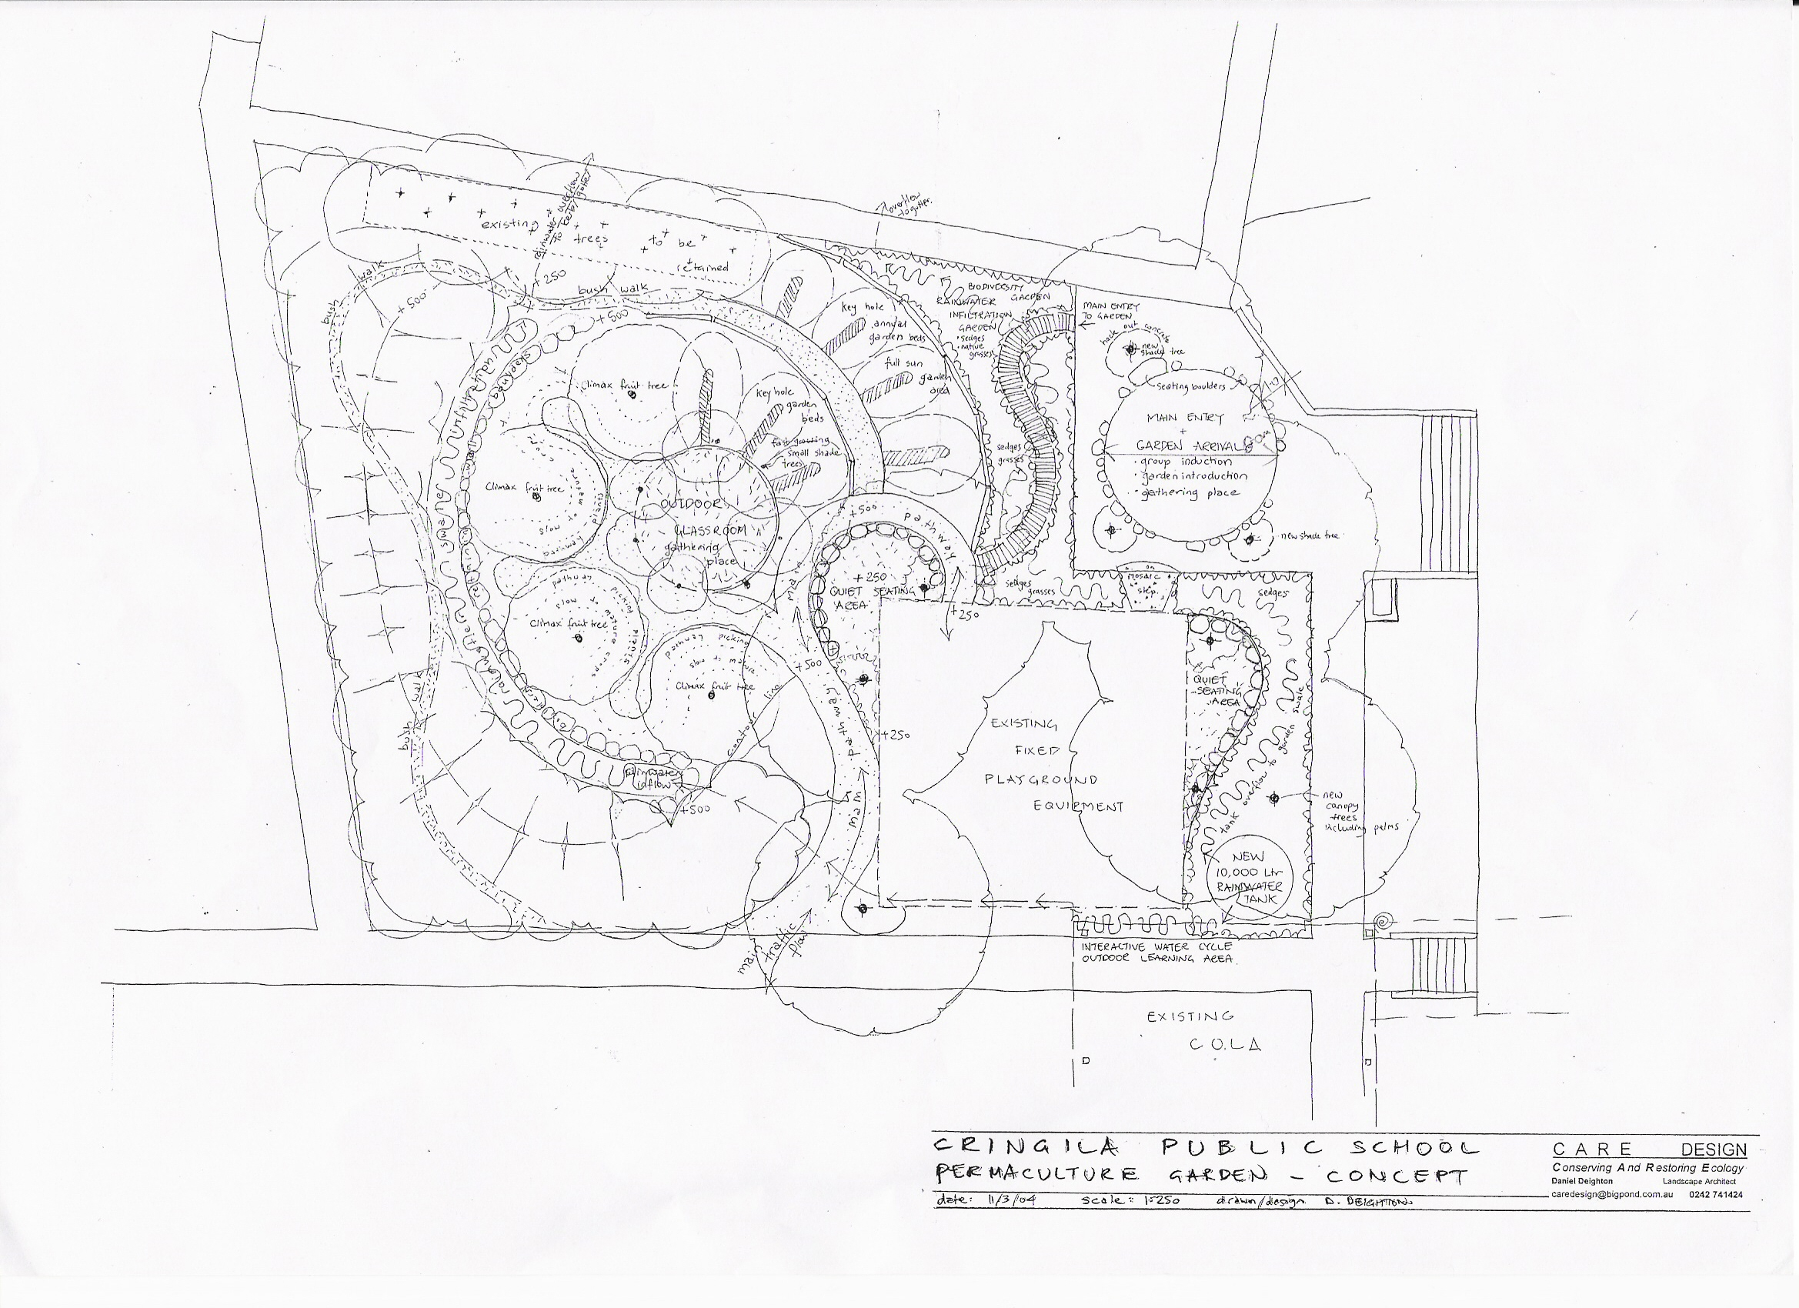
Some of the original planning documents

Slide 14
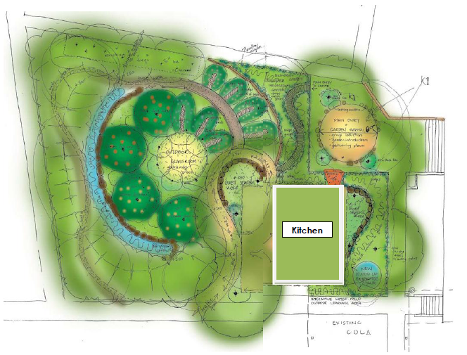
Cringila PS Permaculture Garden design

Slide 15
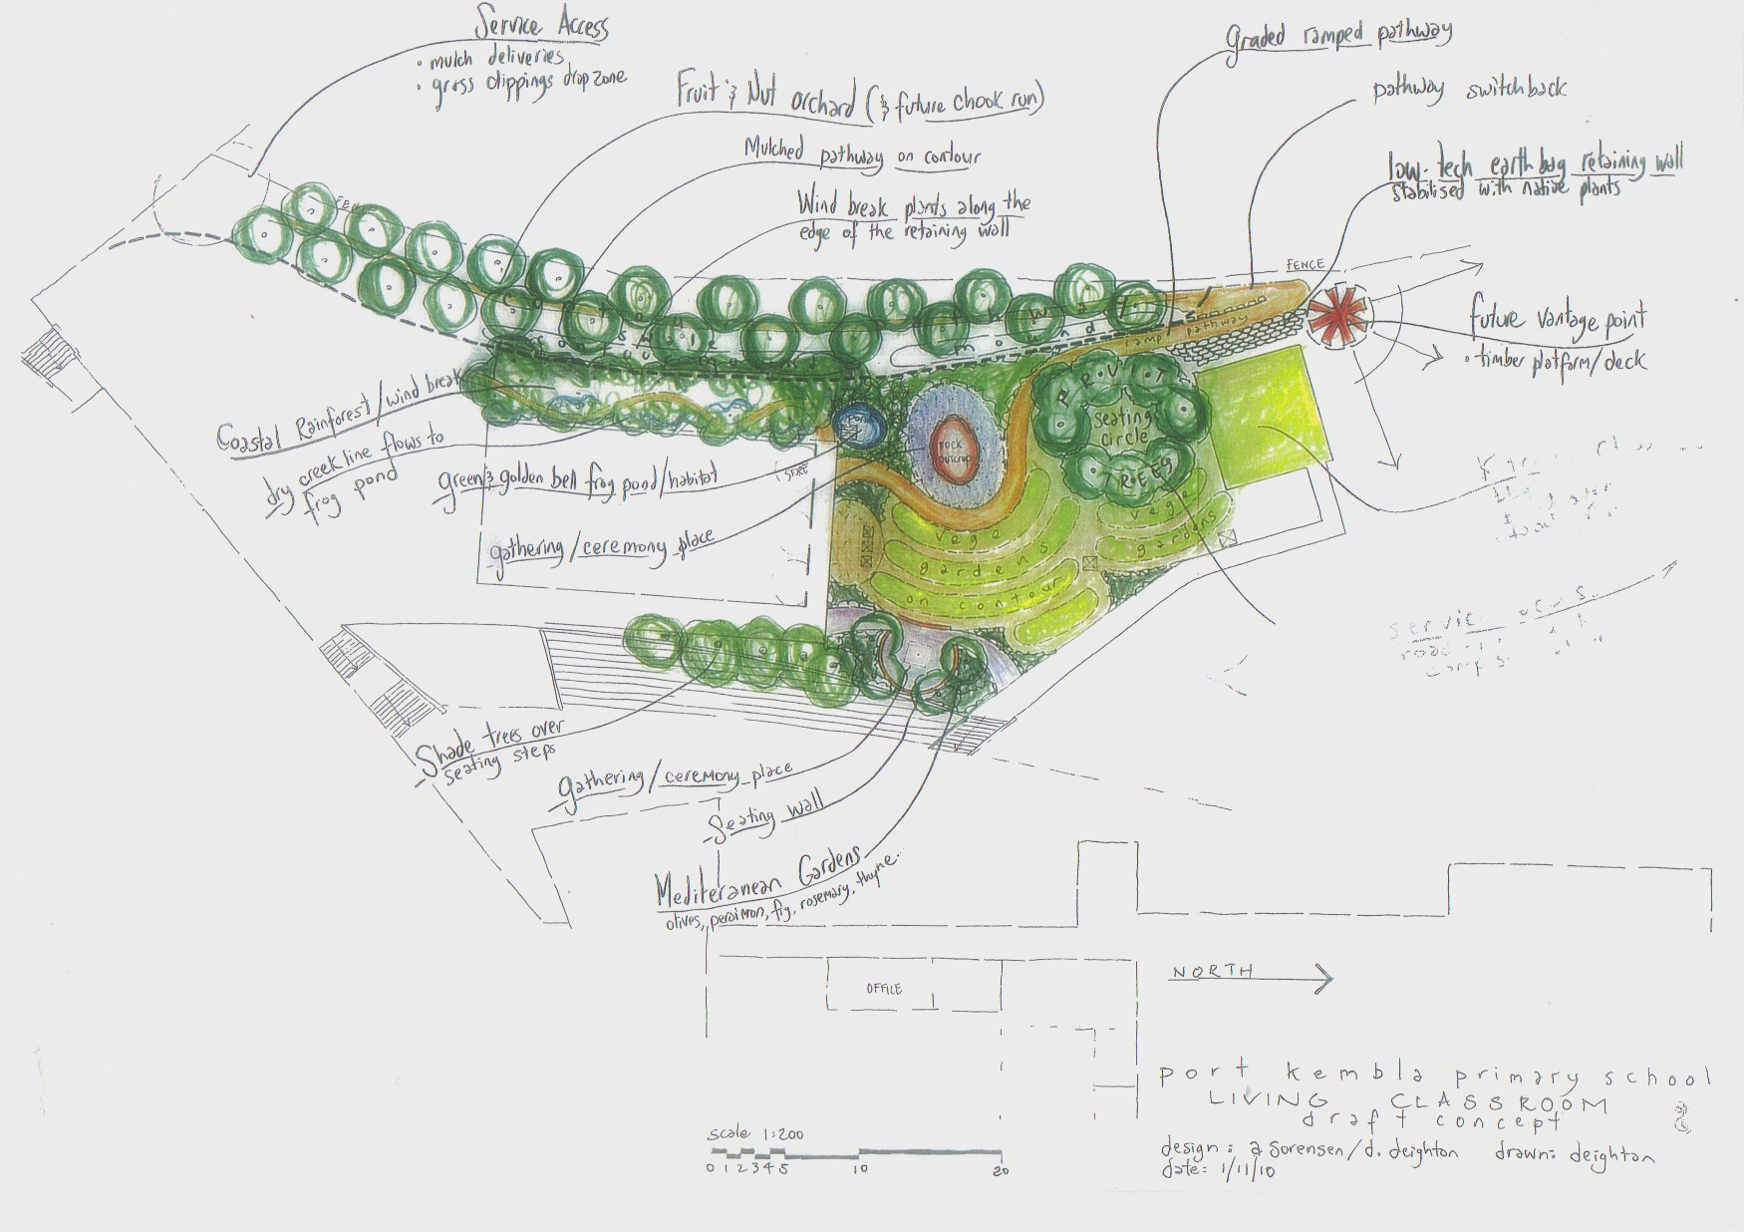
Port Kembla Public School Permaculture Garden Plan

Slide 16
What is the garden primarily used for?
Growing vegetables, which type (Asian, European, mixture)
Plants that kids and community can work with in the future for cooking
Natives
Bush tucker
Teaching kids
Providing habitat
Attracting bird life etc

Slide 18
How will we utilise the garden?
Garden ambassadors as per schools in the Warrawong Community of Schools
Other methods (successes and failures of these techniques trialled by other schools)
A hands on learning space where targeted lessons can occur but also the opportunity to link aspects of the curriculum and/or different Key Learning areas to the garden experience

Slide 19
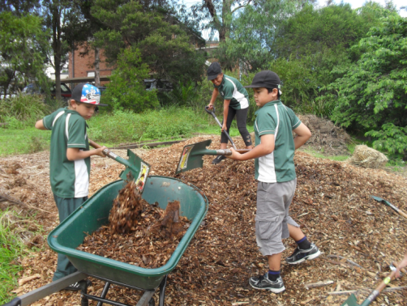
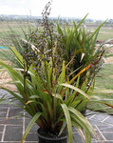

Slide 20
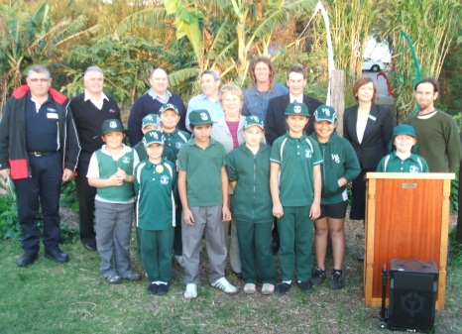
Who is going to be part of the beginning process ?
General assistant
All teachers or one point of contact
Which kids
Can the community get involved?
Local businesses

Slide 21
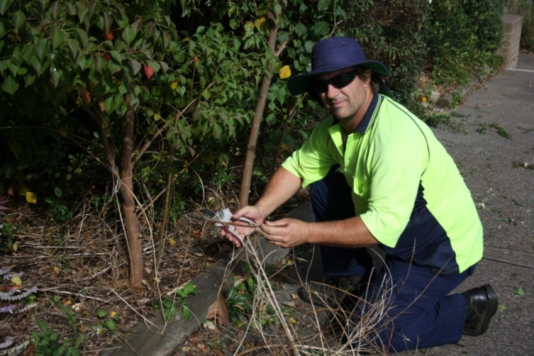
Brett the GA @ Cringila PS

Slide 22
Who can support us?
Warrawong Community of Schools Permaculture Partners network
Other schools who have already started a similar program
Community groups who you can work with collaboratively (Landcare, Conservation Volunteers, Green Corp)
Sustainability NSW, Environmental Trust, State and Federal Government Agencies.

Slide 24
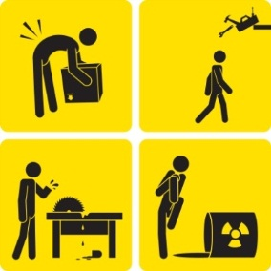
Other considerations

Slide 25
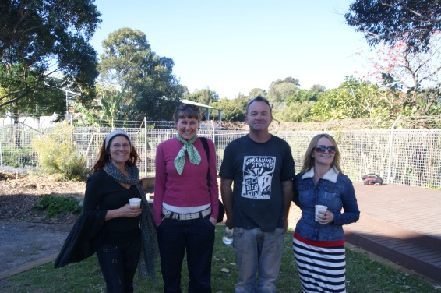
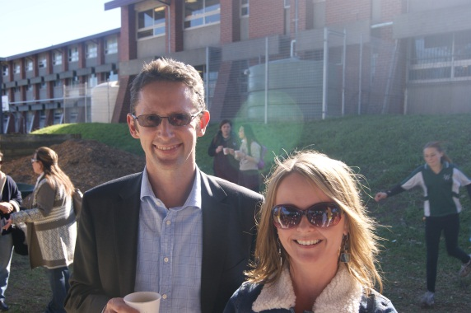
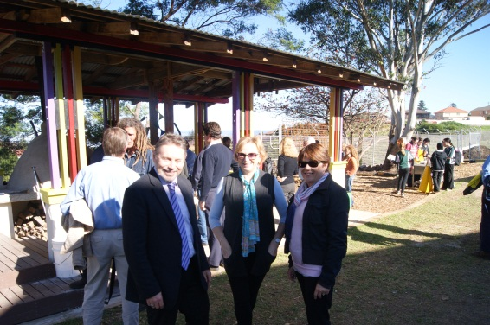
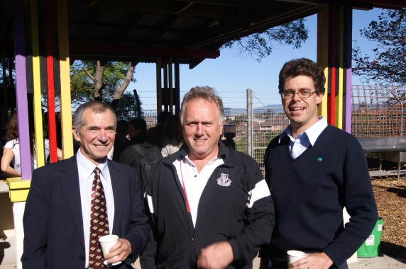
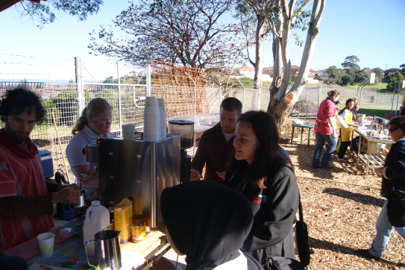
Celebrate your successes

Slide 26
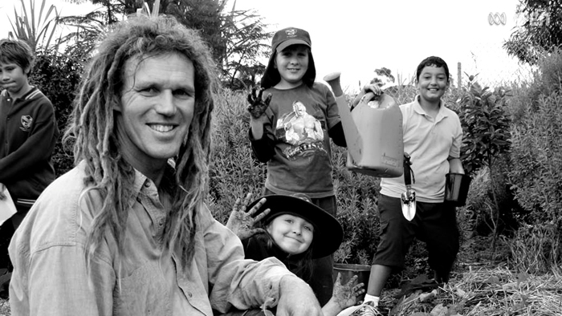
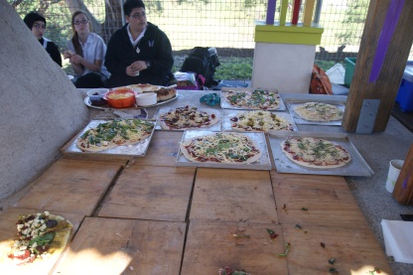
Aaron Sorenson’s five top tips for starting a permaculture project at your school
1. Invest in a permaculture design for the school. Stage the project works, start small and build upon the rising enthusiasm and opportunity.
2. Partner with a local permaculture group/community garden as their in-kind support will be invaluable with experience, knowledge and plant, seed and root material.
3. Start with a coffee machine and/or the outdoor kitchen first preferably with a cob oven. These two elements will be your income generators to support the building of your garden and the hands on program. There is nothing as encouraging as the smell of wood-fired pizza and organic, free-trade coffee to engage the community.
4. You need a ‘troika’ (group of three) – this will need to be the Principal and two teachers who are not retiring within the next three years of your project.
5. Invest in permaculture training for interested staff members. Ongoing staff capacity building will be essential for the long term success of the project.

Slide 27
Reality check
Is there someone at my school other than the Principal, who can be our champion?
Where would the garden go?
Start small but with a bigger vision?
We want to avoid tokenism.
What students would we involve?
Time and money?
Organisational factors?
What equipment will we need?
Who in our community can we involve on our terms?
Where are we now, where do we want to go and what support do we need to get there?

